Slide 1

3-Tier Architecture
Cloud Agnostic Approach

Slide 2

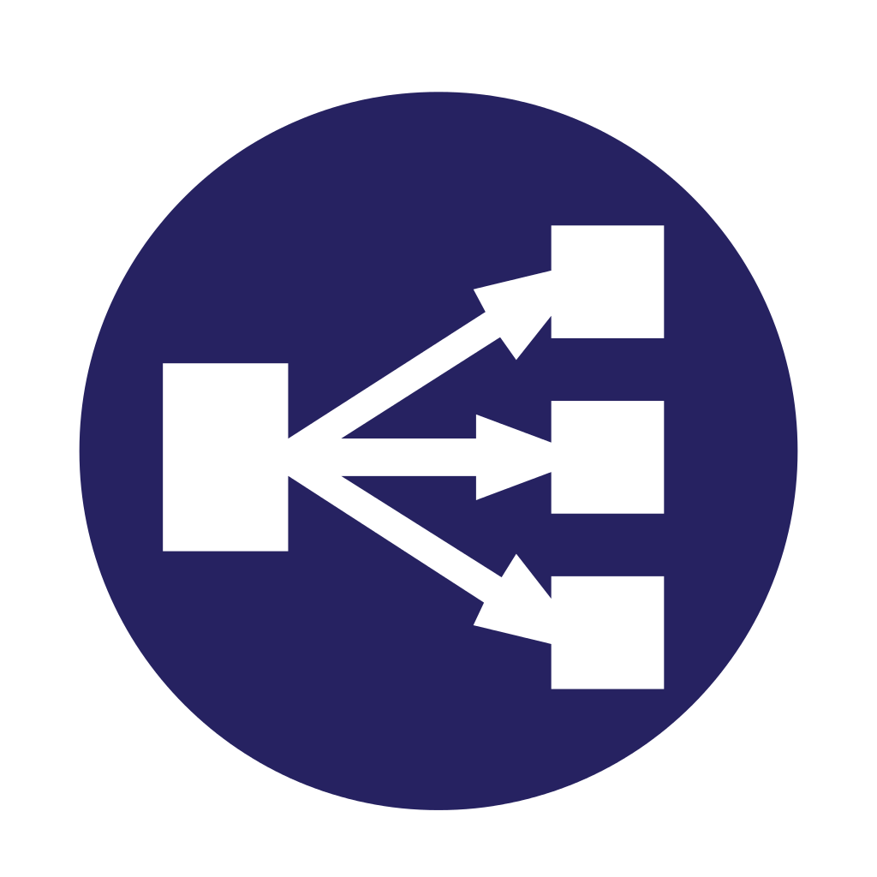



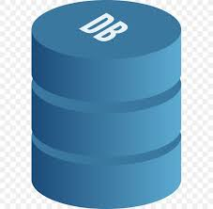
Incoming Traffic
HTTPS
Gateway Layer is the sole point of contact with the outside world. It manage:
Traffic
SSL termination
User Auth(API GW)
Load Balancer
SSL Certificate
Exposed outside
TIER 1 – Gateway Layer
Security Groups
User
TIER 2 – App Layer
Application Layer:
Webserver or Frontend applications serve UI/UX or frontend requests
Backend Applications do the core processing part
3 Tier Architecture usually comprises of:
Gateway Layer
Application Layer
Database Layer
Terraform can be used for Infrastructure automated provisioning (IAC)
Application Scaling can be achieved using containers for application deployment
Database should be Highly Available, spread across zones
VPC/VCN/VNET should encompass the entire network layer
Database Layer is:
Most secure and internal layer
Connection only allowed with APP layer
Read Replica to offset heavy reads
Port Whitelisting
TIER 3 – DB Layer
Database Read Replica

Slide 3
Thank You.
Samratjit Mukherjee

